Slide 1

UNIVERSITY INSTITUTE OF ENGINEERING
COMPUTER SCIENCE ENGINEERING
Bachelor of Engineering (Computer Science & Engineering)
Subject Name: Internet of Things
Subject Code: 20CST-357
IoT Communication Models
DISCOVER . LEARN . EMPOWER

Slide 2
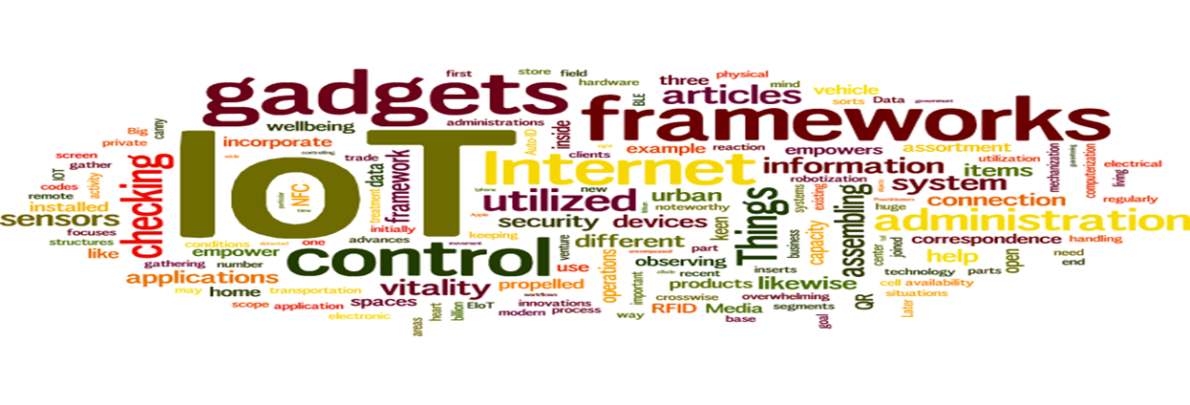
Internet of Things
Course Outcomes:
1. Analyze the basic terminologies associated with IoT and use it.
2. Justify the applications of internet of things and correlate them.
3. Compare different objects and communication strategies and also able to see the issues raised by communication strategies in IoT.
4. Examine the protocols required for communication and packet size required for each application.
5. Illustrate security issues with IoT like security, privacy, communication standard and some other legal issues.

Slide 3
UNIT 2 CHAPTER 3 IoT Communication Models

Slide 4
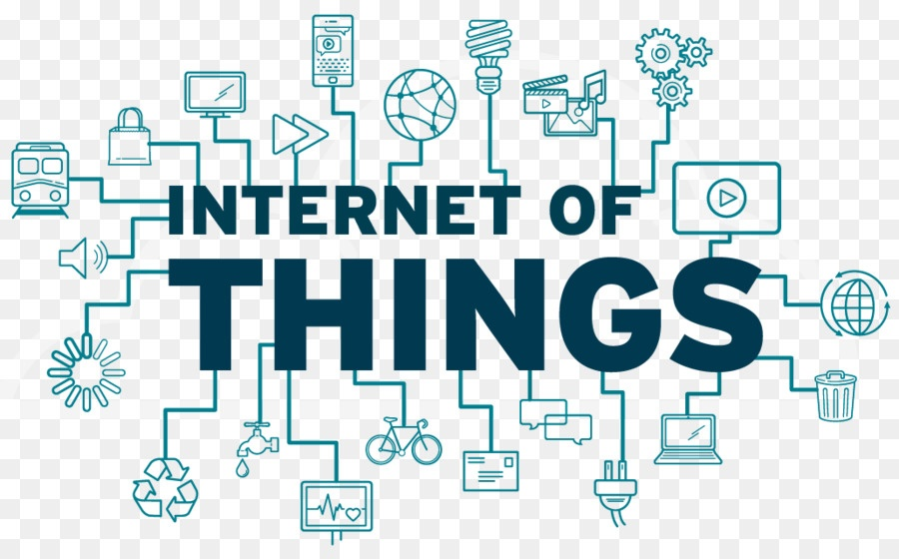
Internet of Things
Device to Device Communications
Device to Cloud Communications
Device to Gateway Model
Device to Device Communications
Backend Data Sharing Model

Slide 5
Communication Models in IoT (CO-3)
The 4 main types of IoT communication models are:
1. Request & Response Model ↔ Client-Server Architecture:
Here, the client needs to put a request, which gets converted to an encoded format on the route and reaches the server to gather information. The data gathered is not preserved between each unconstrained request. On receiving a request, the server downloads necessary data from the site and gets ready to respond. After preparing, the client receives the data and eventually can see the response.
Example: Sending a spreadsheet to the printer — the spreadsheet program is the client.

Slide 6
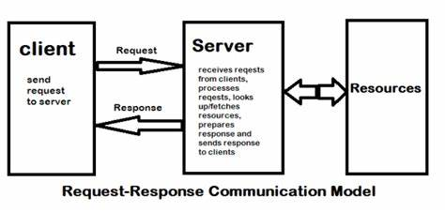

Slide 7
2. Publish subscribe communication model in IoT
The primary source of data in this model is publishers. Brokers manage the data received from publishers without knowing anything about consumers. Consumers pay support to articles tracked by brokers. Therefore, it is the responsibility of the brokers to receive data from publishers and send it to eligible consumers. In general, sellers get information about buyers only, about a specific topic that the publisher does not know.
Example: Public sensors with a massive base of uniform users that will use the data.

Slide 8
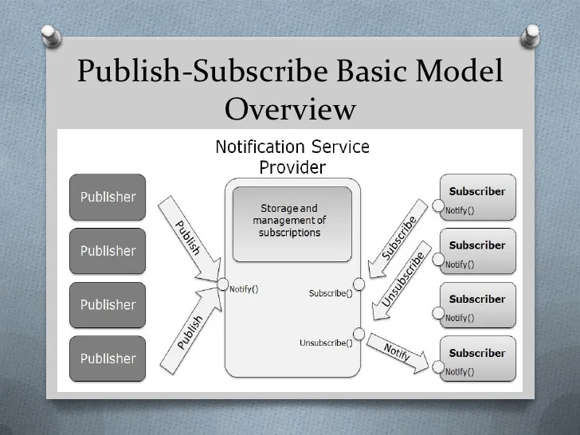

Slide 9
3. Push-pull communication model in IoT
Publishers and consumers are unaware of each other. Publishers issue data and push it online. Consumers, on the other side, pull the data pushed online. Therefore, the line acts as a message bar, where the difference arises from the level of push or data drag on the publisher and consumer sides.
Example: Queues help in decoupling the messaging between the producers and consumers.

Slide 10
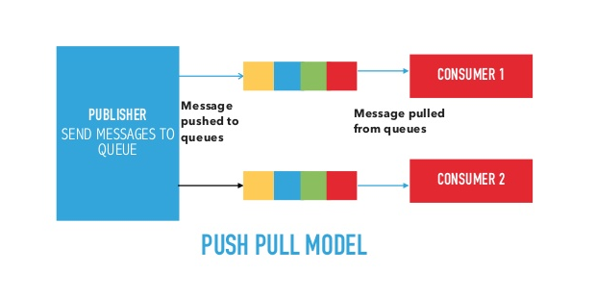

Slide 11
4. Exclusive pair communication model in IoT
Being an IoT bidirectional communication model, this model combines full dual communication between client and server. The connection does not change and remains open until the client submits a request to close the connection. The server has a record of all open communication. It is an entire country communication model, and the server is capable of all open communication.
Example: The Web Socket-based communication API.

Slide 12
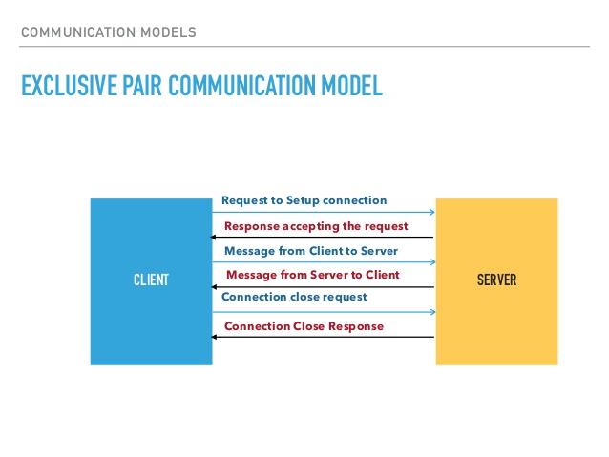

Slide 13
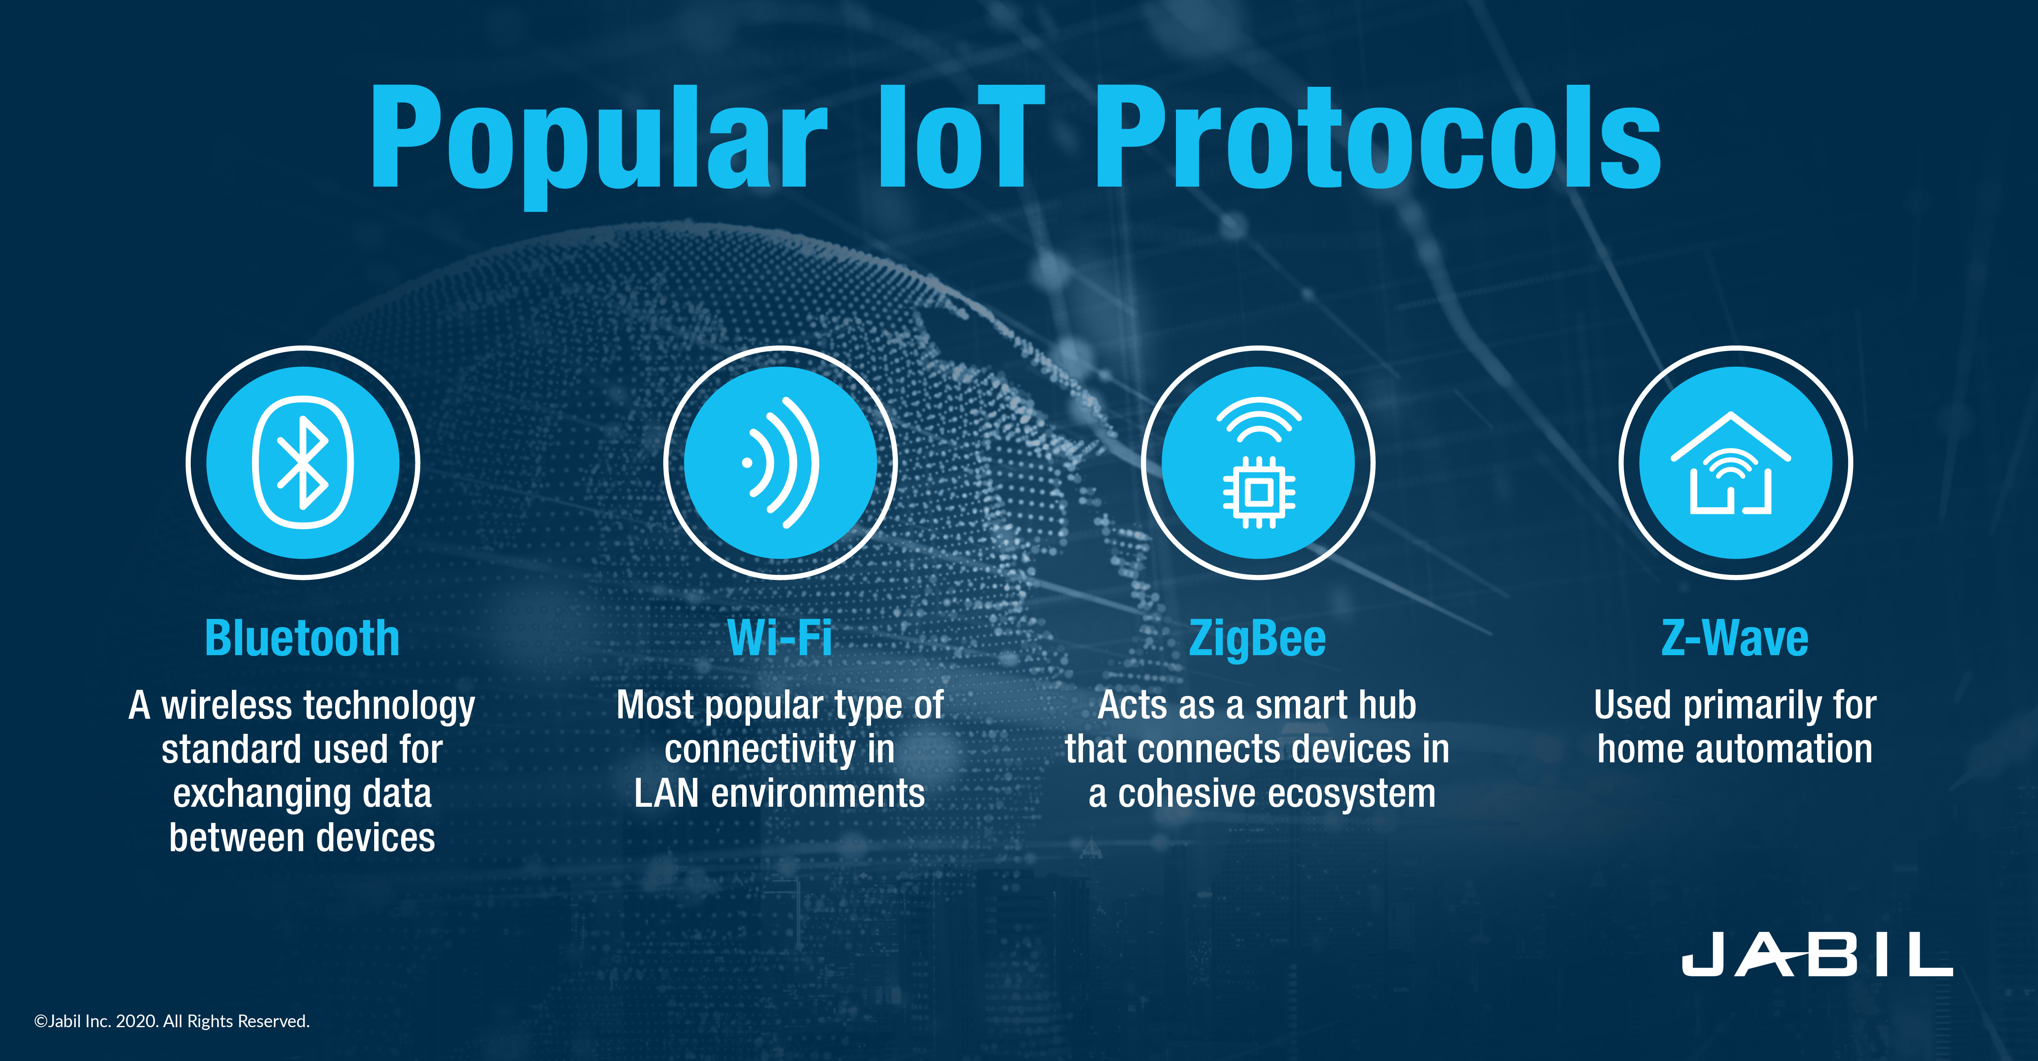

Slide 14
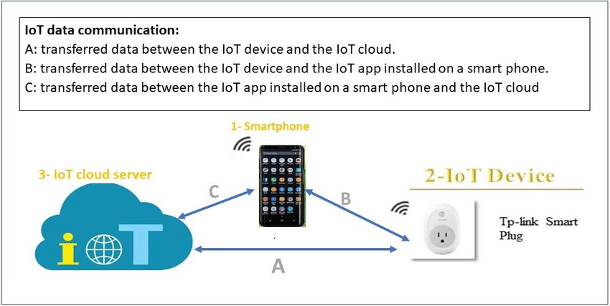
Device to Device Communication Models (CO-3)

Slide 15
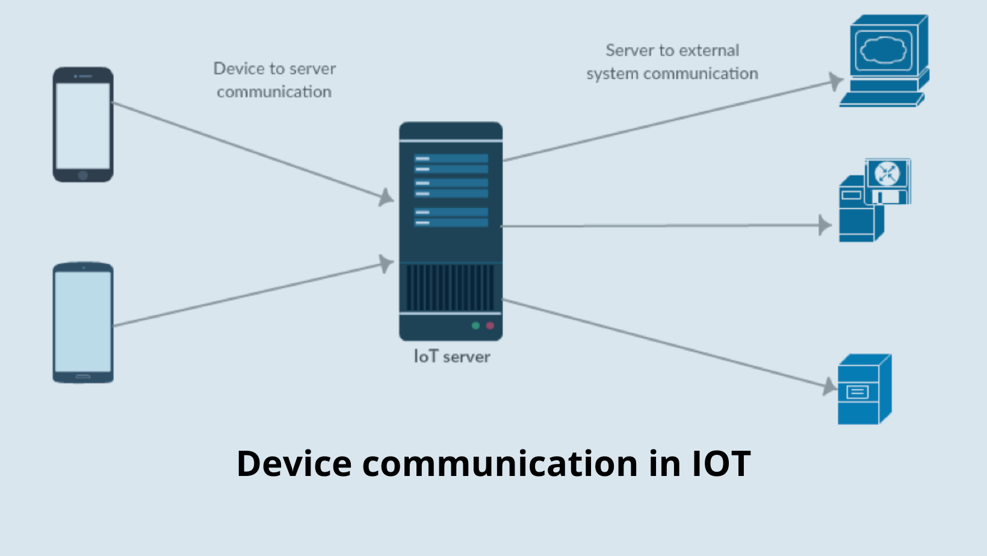
Autonomous computing, communication, and collaboration among devices have their importance to transform the digital world. Emerging technology device-to-device (D2D) communication has a great impetus to facilitate peer-to-peer network.

Slide 16
Examples of IoT Devices
1. Home Security
2. Activity Trackers
3. Industrial Security and Safety
4. Augmented Reality Glasses
5. Motion Detection

Slide 17
Device to Cloud Communications (CO-3)
There are four best practices to connect different types of devices to the cloud:
1. Directly integrate IoT SDK (Software Development Kit) for resource-rich devices
2. Rely on a communication module for resource-constrained devices
3. Use a local gateway for non-network devices
4. Use a cloud gateway for private-protocol devices with network capabilities

Slide 18
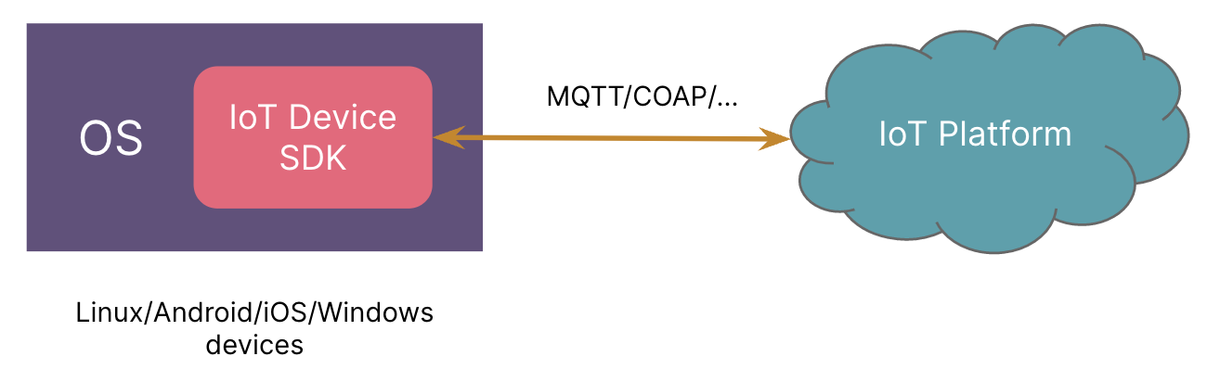
Directly integrate IoT SDK for resource-rich devices
With the development of high-performance hardware, many smart devices have complete OS such as Linux, Android etc. These devices also have a Wi-Fi or cellular network.
At the operating system level, network communication problems have already been resolved. We only need to develop applications which integrate the IoT SDK of the cloud platform and the communication link with the cloud will have been established.
Integrating IoT SDK for resource-rich devices

Slide 19
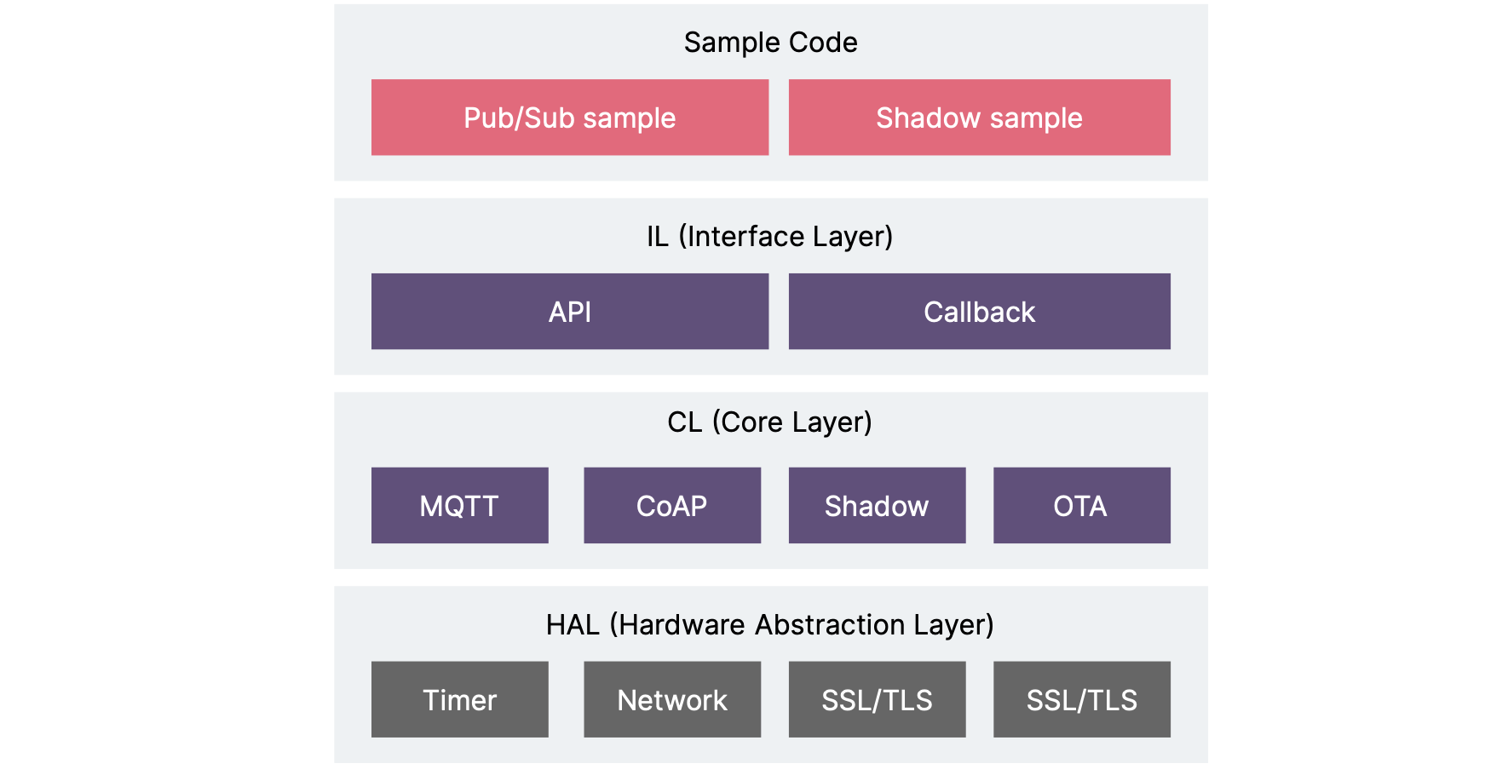

Slide 20
There are 4 layers of the IoT SDK. From bottom to top:
1. The HAL (hardware abstraction layer) abstracts the support function interface of different OS (operating systems) to the SDK. This enables the SDK to be ported to different hardware environments, different OS, and even bare chip environments.
2. The core layer completes the function encapsulation of MQTT/CoAP communication based on the HAL layer interface, including MQTT connection establishment, message sending and receiving; CoAP connection establishment, message sending and receiving; shadow device operation; OTA firmware status query, download and upgrade.
3. Interface layer, providing API and callback function definitions, isolating the core layer and the application.
4. Provide sample programs so that developers can quickly learn how to use the SDK.

Slide 21
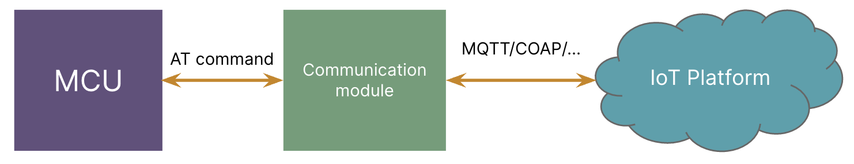
Rely on a communication module for resource-constrained devices
In the IoT scenario, a large number of devices are resource-constrained, with RTOS, or even without an operating system, using MCU + communication modules to establish their link to the cloud.
There are many suppliers of cellular modules (NB-IoT/2G/3G/4G) on the market. The AT commands of each company are different, which makes developing device-side applications very difficult.
When we need to connect MCU to an IoT Platform, we should always carefully select the cellular modules and check whether they are suitable for a specific IoT platform.

Slide 22
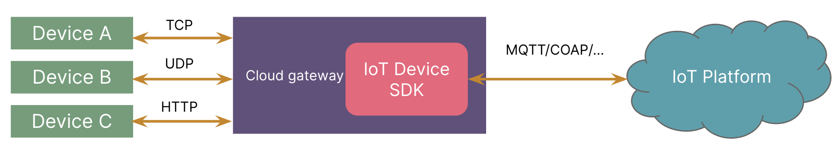
Use a cloud gateway for private-protocol devices with network capabilities
Devices that directly connect to the cloud gateway
For some devices, they already have the ability to connect to the internet, but the protocols vary according to device manufacturers. We don’t want the IoT platform layer to handle the parsing of these protocols directly;an intermediate layer should satisfy the protocol conversion work to make the data meet the unified format of the IoT platform.
This intermediate layer is the cloud gateway. The cloud gateway is at the front of the platform. It receives data from the device side, completes message parsing, and then sends a message to the IoT platform with IoT device SDK.

Slide 23
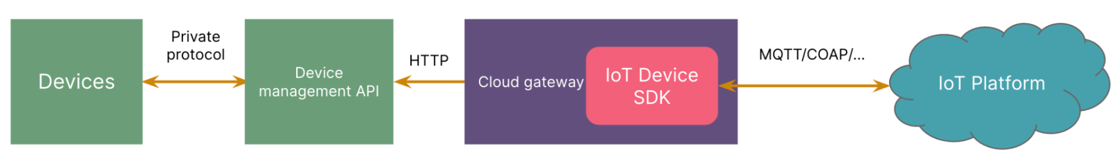
Devices that connect to the cloud gateway indirectly
Some device vendors already provide a mature system which manages the devices and provides API. In this case, we can have another form of cloud gateway: Cloud to cloud connection. ​​Making full use of the existing system will make the overall system more stable and give clear rights and responsibilities.
Using a mature system will bring us higher development efficiency, but it’ll also introduce another midware, which will increase communication time.

Slide 24
Device to Gateway Model (CO-3)
The Need For IoT Gateway:
Organizations commonly deploy an array of different IoT devices, which can make it difficult to monitor and manage these devices. An IoT gateway is a centralized hub that connects IoT devices and sensors to cloud-based computing and data processing.
Modern IoT gateways often allow bidirectional data flow between the cloud and IoT devices. This allows IoT sensor data to be uploaded for processing and commands to be sent from cloud-based applications to IoT devices.
How Does An IoT Gateway Work:
IoT gateways are designed to simplify and streamline IoT device communications and management. Some common functions of IoT devices include:
1. Inter-Device Communications
2. Device-to-Cloud Communications
3. Data Preprocessing
4. IoT Device Security

Slide 25
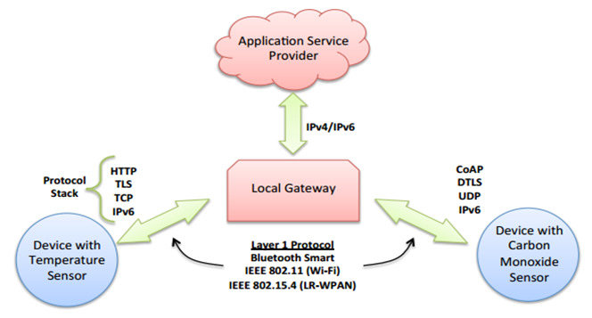

Slide 26
IoT Gateways In The IoT Architecture (CO-4)
IoT infrastructure can be divided into four architectural layers. These include:
1. Sensor Layer: At the sensor layer, devices collect data for future processing. IoT devices operate at this layer.
2. Network or Data Acquisition Layer: At this layer, data is aggregated from multiple sources and securely transmitted to processing systems. Data acquisition systems (DAS) are responsible for aggregating and converting data to a desired format. IoT gateways operate at this level to provide secure connectivity between IoT devices and processing infrastructure.
3. Data Pre-processing Layer: At this layer, IoT sensor data undergoes pre-processing and basic data analytics to reduce data volume before it is transmitted on to cloud-based infrastructure. IoT edge devices operate at this layer.
4. Cloud Analysis or Application Layer: Cloud-based infrastructure performs in-depth data analytics and provides applications and users with access to data and analytic results. Data storage or warehousing may also occur at this layer.

Slide 27
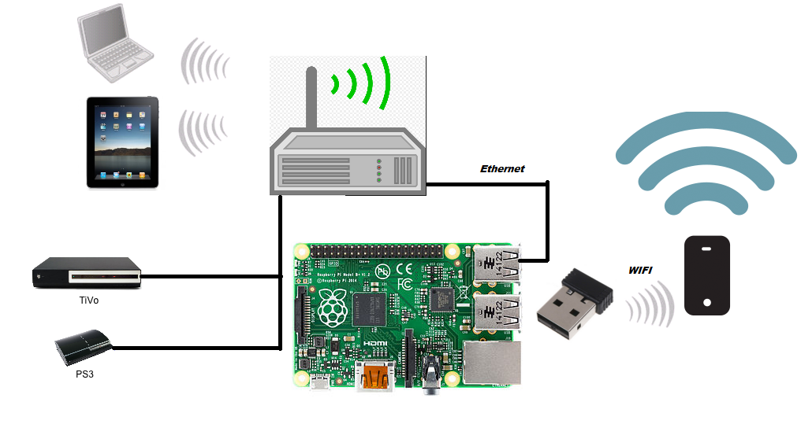

Slide 28
IoT Edge Security (CO-4)
IoT gateways are an example of an intelligent IoT device deployed at the network edge. These devices can provide both benefits and downsides for IoT security, including:
1. Data Minimization: IoT gateways are responsible for filtering data produced by IoT devices before sending it out over the Internet. This helps to reduce both the volume of data sent and the amount of sensitive information that may be leaked in network communications or via compromised cloud-based servers.
2. Decentralized Infrastructure: IoT gateways have limited data processing capabilities, which have benefits and drawbacks for security. Distributed data processing via edge computing helps to improve resiliency and data minimization; however, a distributed architecture may be more difficult to secure because it cannot be protected by perimeter-based defenses.
3. Edge-Based Security: IoT gateways can incorporate integrated security functionality that sits between IoT devices and the public Internet. This can help to protect an organization’s IoT devices and the sensitive data that they collect against cyber threats because the IoT helps to close the security gaps that are common in IoT devices.

Slide 29
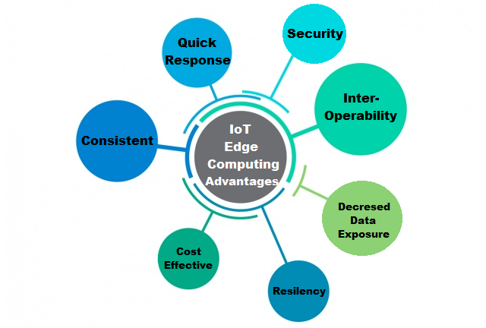

Slide 30
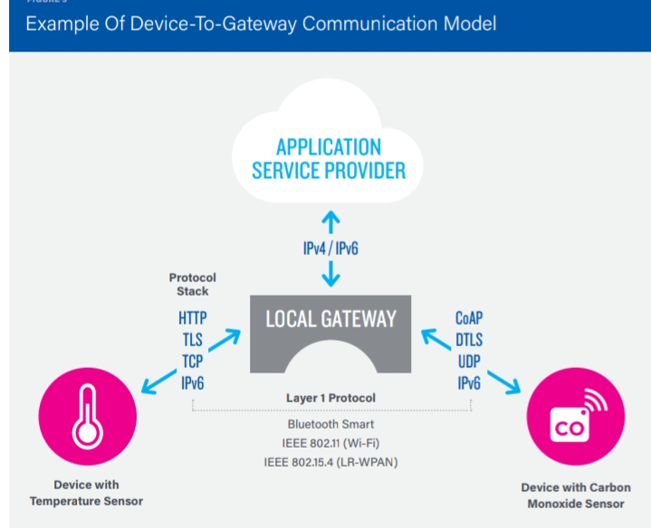

Slide 31
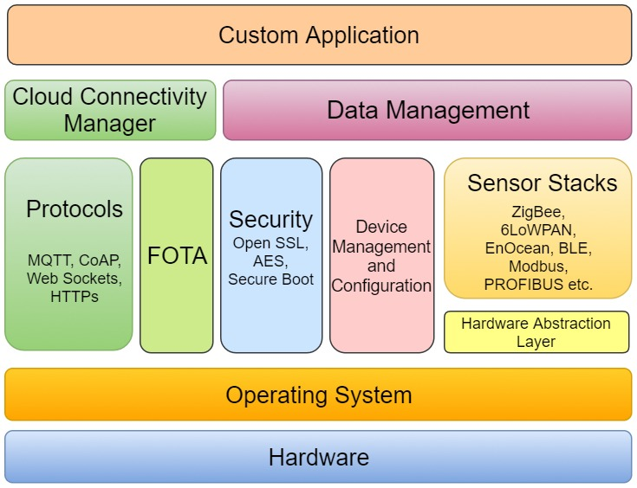

Slide 32
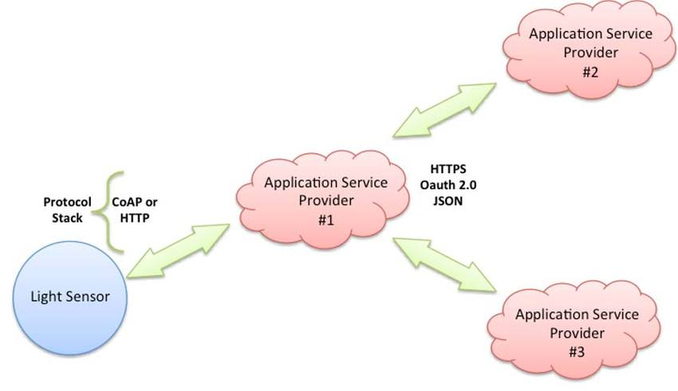
Back-End Data Sharing Model (CO-3)

Slide 33
The back-end data-sharing model refers to a communication architecture that enables users to export and analyze smart object data from a cloud service in combination with data from other sources. This architecture supports “the (user’s) desire for granting access to the uploaded sensor data to third parties”. This approach is an extension of the single device-to-cloud communication model, which can lead to data silos where “IoT devices upload data only to a single application service provider’’.

Slide 34
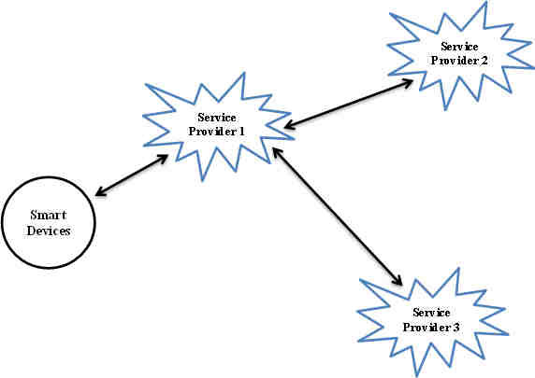

Slide 35
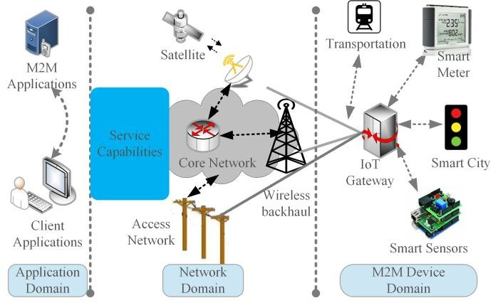

Slide 36
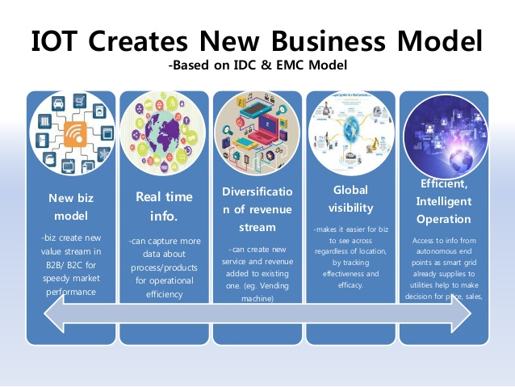

Slide 37
Summary
Four common communications models described by the Internet Architecture Board include: Device-to-Device, Device-to-Cloud, Device-to-Gateway, and Back-End Data-Sharing. These models highlight the flexibility in the ways that IoT devices can connect and provide value to the user.
It will be possible to innovate technology and increase the economy via effective IoT communication modules, IoT communication patterns, IoT communication standards, etc. As more gadgets become interconnected, they will be able to use data streams to develop new goods. Under the device-to-device communication paradigm, devices can communicate directly without needing an application server. The protocol used is often proprietary. The Internet of Things’ stateless communication style allows devices to connect across several networks.

Slide 38
Quiz
1. What are the important components that exist in the Internet of Things? (Choose all that apply)
a. Hardware b. Software
c. Infrastructure d. Programming
2. Internet of Things impact the sustainability of the business and will it have any impact on the environment
a. True b. False
3. What is the Internet of everything?
Data Exchange b. Protocol
c. Security d. Development
4. In IoT which of protocol provide Full-Duplex communication is
a. WebSocket b. HTTP
c. MQTT d. CoAP
5. What is the Advantage of MQTT over HTTP?
More secure b. Lightweight
c. Polling is not required d. Both a and b
6. How many bit addresses are there in IPv4?
32 b. 28
c. 128 d. 56

Slide 39
7. Take a moment to ponder some of the uses of IoT: predictive maintenance, industry safety solutions, building and home automation, remote patient monitoring, asset tracking, and fraud detection.
All of these uses have a common theme that is the reason IoT is garnering so much attention. What is it?
a. All the use cases use ML and AI which is growing more rapidly
b. All the use cases use Sensors in a more unique way
c. All the use cases gaining a unique environment that can not be obtained in any other way
d. None of the above
8. You are designing an IIoT network to monitor crowd movements at a baseball stadium. When the average walking speed of the crowd drops below 1ft/second, additional gates will open.
You are sending the data from the gate sensors to BigQuery every minute. Which type of query should you use for this task?
a. Batch Query b. Interactive Query
c. Both of them simultaneously d. None of them are usually use in IIoT network
9. Which of the following Hardware can be alone used as IoT Gateway?
Raspberry Pi b. NodeMCU ESP8266
c. Arduino UNO d. Both a and b
10. Which of the following database is recommended for unstructured data for IoT application?
a. Microsoft SQL
b. Postgres SQL
c. Mongo DB
d. None of the above

Slide 40
REFERENCES
Text Books:
Ovidiu Vermesan, Peter Friess, “Internet of Things-Converging Technologies for Smart Environments & integrated Ecosystem”, River Publications Netherlands.
Internet Society, “An overview of Internet of Things”.
3. IoT Fundamentals: Networking Technologies, Protocols, and Use Cases for the Internet of Things by David Hanes, Gonzalo Salgueiro, Patrick Grossetete, CISO Press.
Reference Books:
Pfister, Cuno, “Getting started with the Internet of Things: connecting sensors and microcontrollers to the cloud", O'Reilly Media, Inc.”, 2011.
Greenfield, Adam,” Everyware: The dawning age of ubiquitous computing”, New Riders, 2010.
3. The Internet of Things, revised and updated edition (The MIT Press Essential Knowledge series) by Samuel Greengard, MIT Press.
Web Links:
1. https://www.geeksforgeeks.org/communication-models-in-iot-internet-of-things/
2. https://upscfever.com/upsc-fever/en/programming/iot/chp6.html
3. https://gyansanchay.csjmu.ac.in/wp-content/uploads/2022/08/iot-communication-model.pdf
Video Links:
1. https://www.youtube.com/watch?v=D35Gzr2PvrY
2. https://www.youtube.com/watch?v=rOfzo65XCHw
3. https://www.youtube.com/watch?v=lVh9GUt69Ms

Slide 41
THANK YOU

